Slide 1


Course Overview and Introduction to Wetland Treatment Systems
Wetland Design and Restoration (EES 6309)
Week 1
David Kaplan, Ph.D. (dkaplan@ufl.edu)
UF Environmental Engineering Sciences
www.watershedecology.org

Slide 2
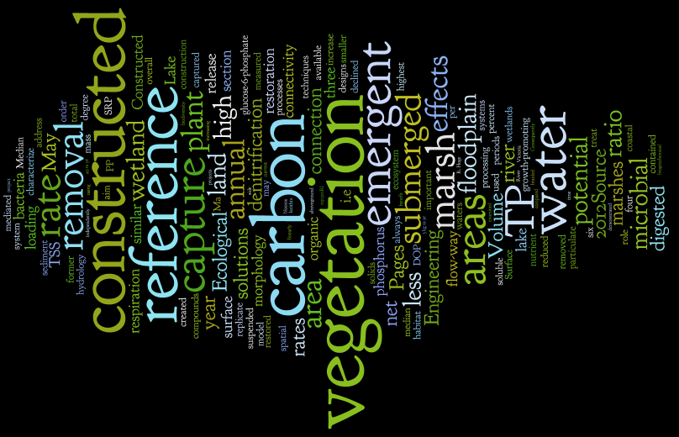
Wetland Design and Restoration
Word cloud built from the Ecological Engineering RSS feed via www.wordle.net

Slide 3
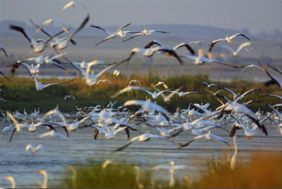
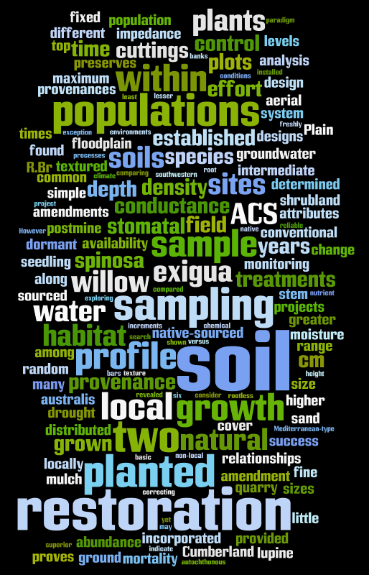
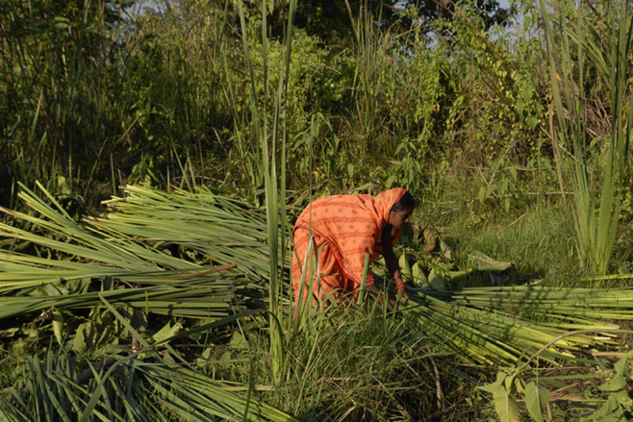

Wetland Design and Restoration
Word cloud built from the Restoration Ecology RSS feed via www.wordle.net

Slide 4
Wetland Design and Restoration
Word cloud built from the Ecological Engineering RSS feed via www.wordle.net
Word cloud built from the Restoration Ecology RSS feed via www.wordle.net

Slide 5
Wetland Design and Restoration
Hydrology
Soils
Vegetation
Microbes
Climate
Models
Success
Criteria
Costs
Permits
Public
H₂O Quality
...
Word cloud built from the Ecological Engineering RSS feed via www.wordle.net
Word cloud built from the Restoration Ecology RSS feed via www.wordle.net

Slide 6
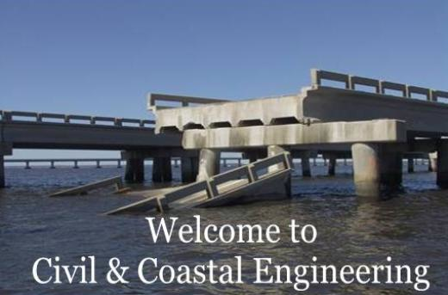
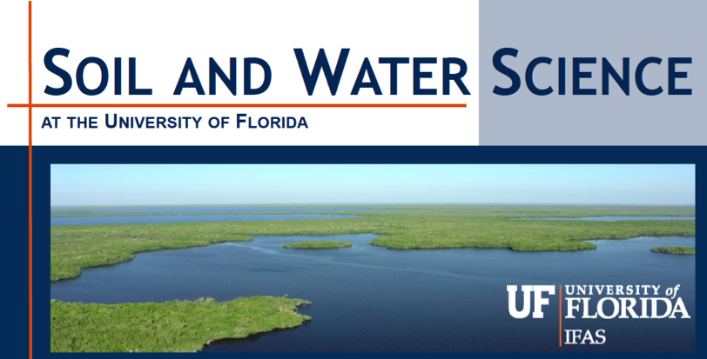
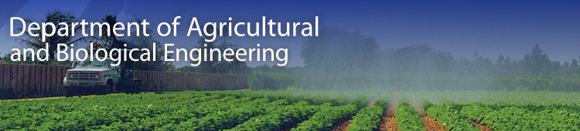
Motivations…why are we here?
Who are we?
21 EDGE students
12 On-campus students
Departments represented:
Environmental Engineering Sciences
SFRC
Ag. and Bio Engineering
Biological Engineering
Soil and Water Science
Who are you? One question…

Slide 7
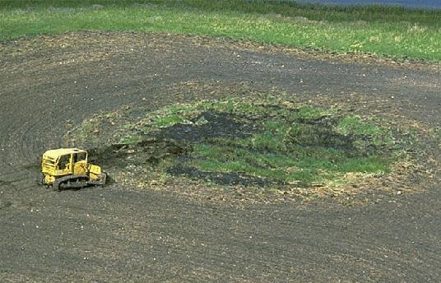
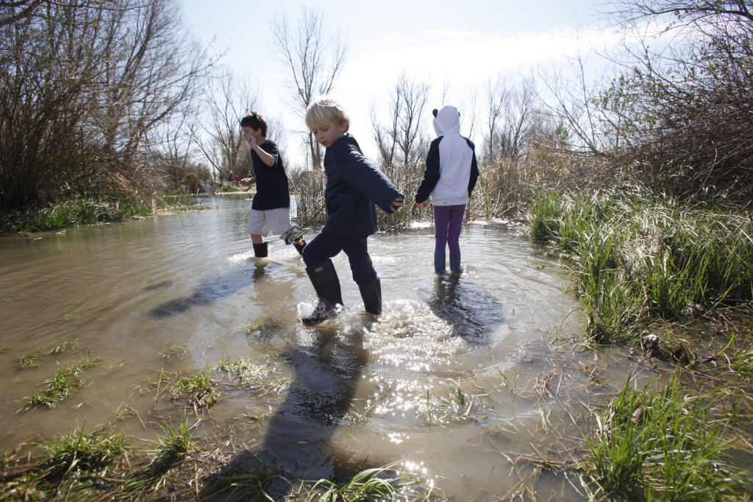
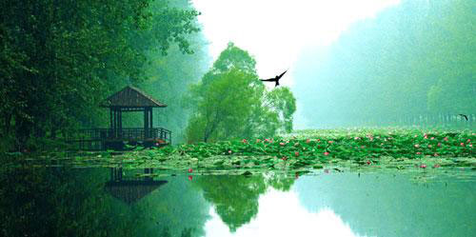
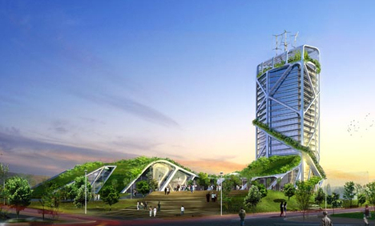
Motivations…why are we here?
Environmental Protection
www.quokka.wikispaces.com/Causes+of+Endangerment
www.davisenterprise.com/visitors-guide/explore-local-wetlands/
www.china.org.cn/travel
www.greenprophet.com/
Affinity for Wetlands
“Green” Design

Slide 8
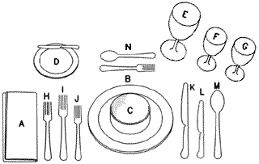
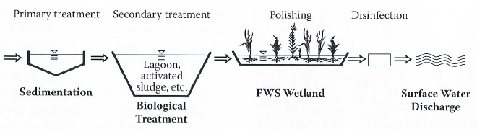
Guiding Questions: Wetland Treatment Systems
What are wetland treatment systems?
Why are they an important technology?
Where and when should they be used?
How do they work? How are they designed?
Why do WTS sometimes fail?
What can we do to improve WTS performance?

Slide 9
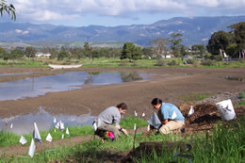
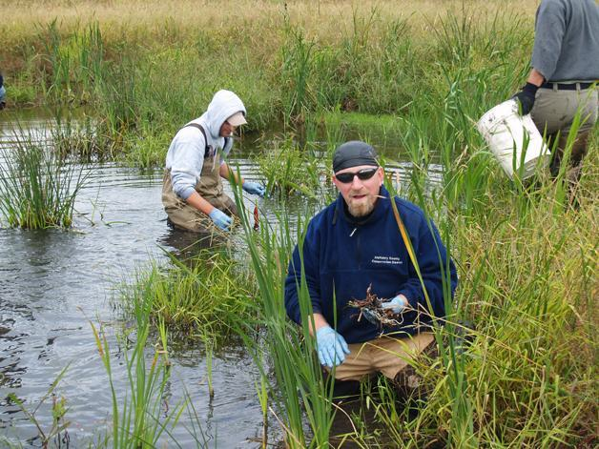
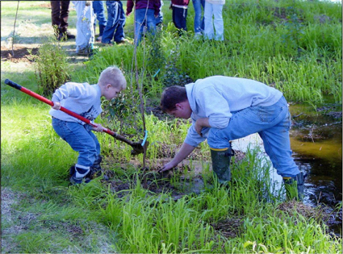
Guiding Questions: Wetland Restoration
How/why are ecosystems degraded?
What is restoration?
Why restore degraded ecosystems?
Is restoration possible?
What does the restoration approach assume?
How do you do it?
How do you know if you’ve succeeded?

Slide 10
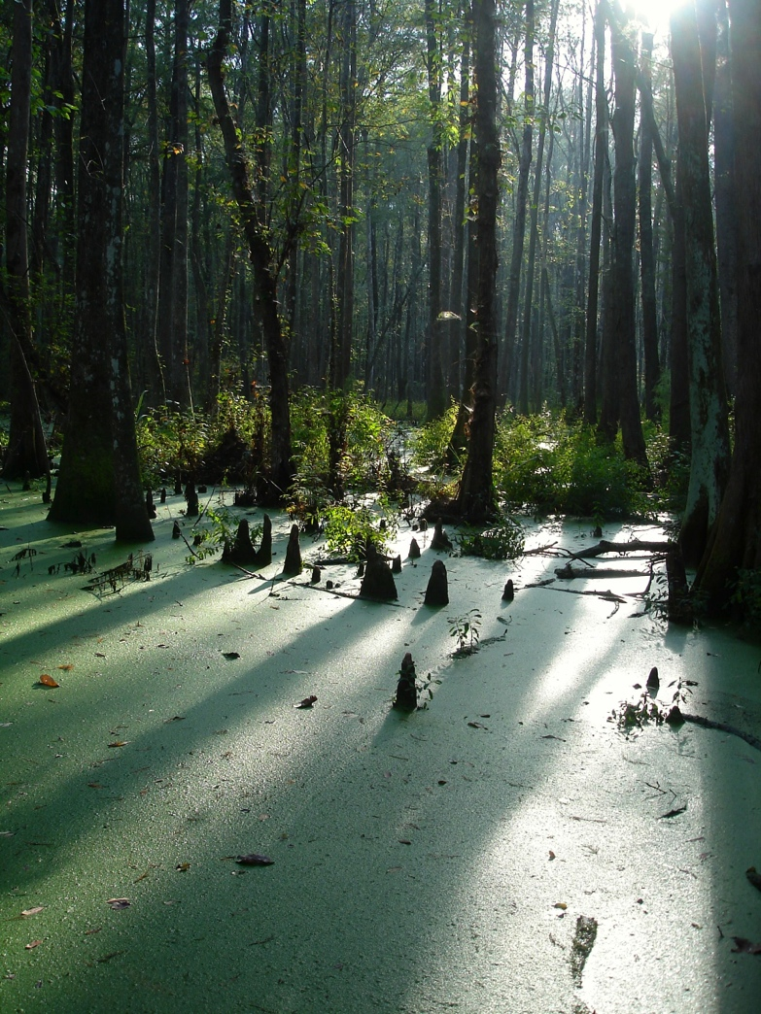
Today’s Lecture
Syllabus, administration, etc.
Schedule, field trips
Textbook and readings
Assignments
Introduction to WTS
  Why WQ Treatment?
  WTS History
  WTS Types
  Applications
Natural WTS: Hardeeville, SC

Slide 11
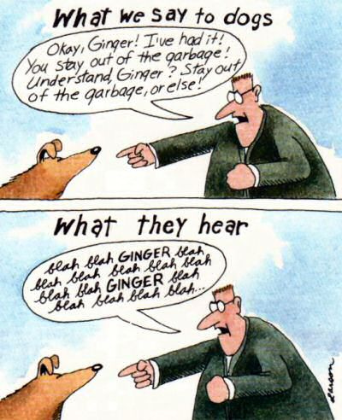
Communication
Class website (UF e-Learning): https://lss.at.ufl.edu
Course e-mail: Please use e-Learning for ALL correspondence. Set up forwarding. I usually reply within 24 hours.
Office Hours:
Immediately after class and by appointment (6 Phelps Lab)
© Gary Larson

Slide 12
Schedule

Slide 13
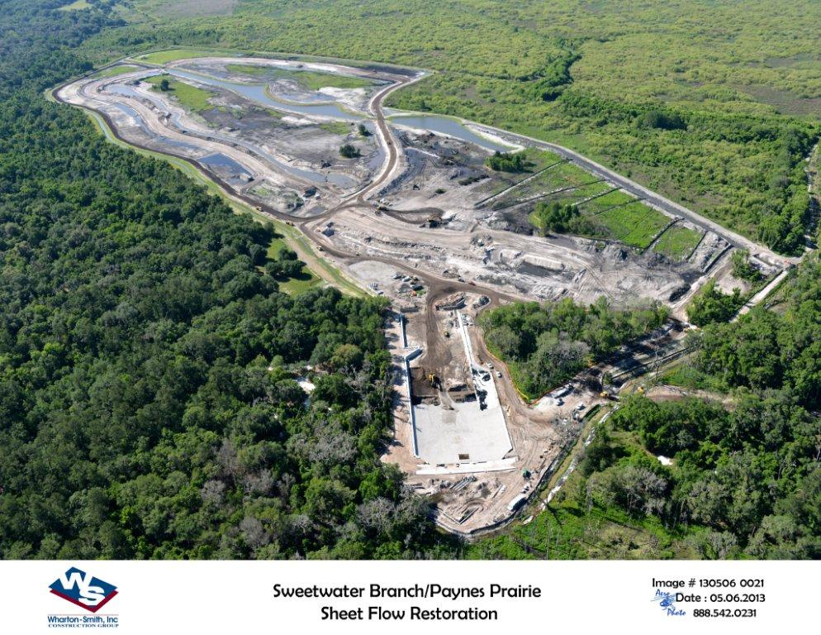
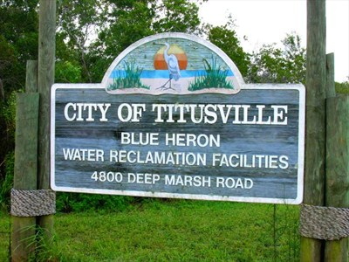
Field Trips
Sweetwater Branch/Paynes Prairie Enhancement Wetland (Gainesville) & Waldo Treatment Wetlands
Central Florida WTS Tour
Indian River County
Brevard County
Titusville Blue Heron
Orlando Easterly (Iron Bridge)

Slide 14
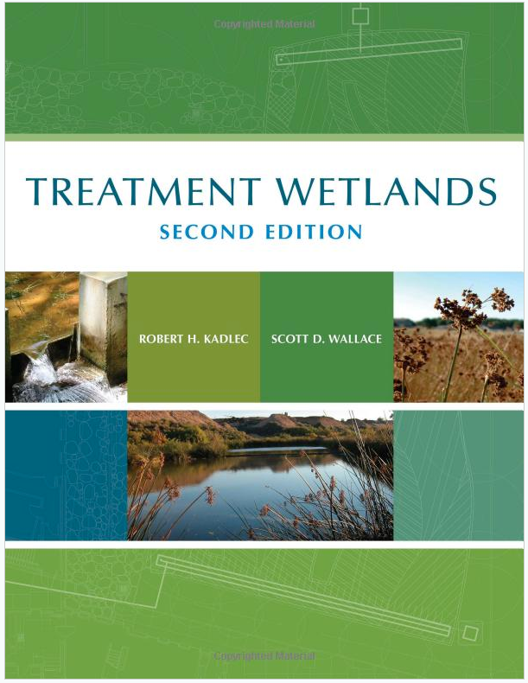
Textbook and Readings
Kadlec and Wallace, 2009
E-Book Available for FREE!

Slide 15
Assignments – Participation

Slide 16
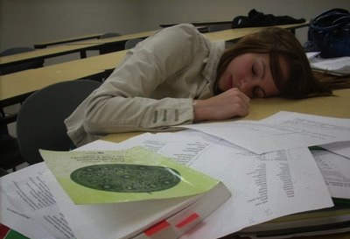

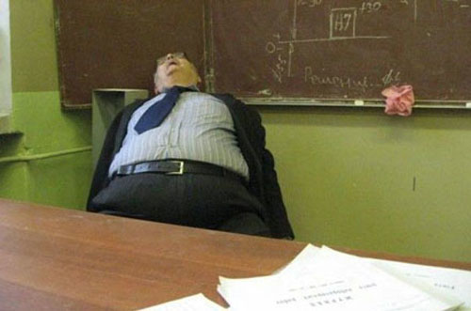
Assignments – Participation

Slide 17
Assignments – Participation

Slide 18
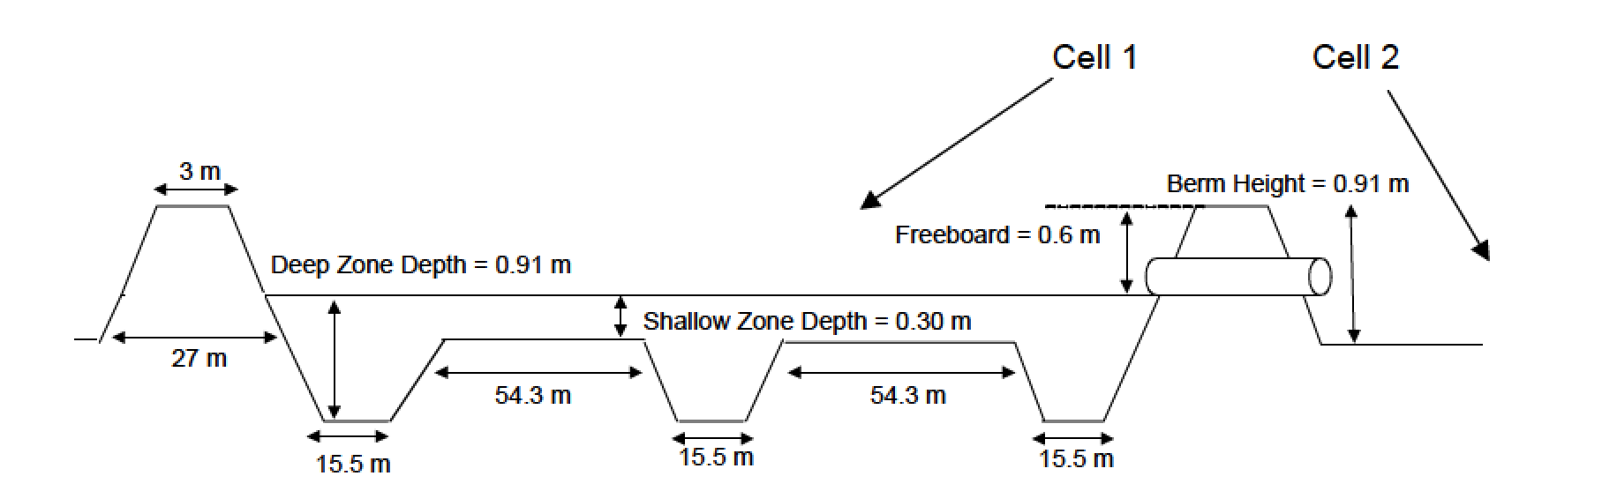
Assignments – Mini-Projects (aka HW)
Individual Work
Two Weeks to Complete
Content, Format, Style
Project 1: Wetland Hydrologic Assessment
Project 2: Wetland Design Tools and Using the NADB v.2
Kaplan, 2007

Slide 19
Assignments – Synthesis Paper
Focused on emerging topics in wetland restoration or WTS
Original figures are strongly encouraged
8-10 pages (double-spaced, references excluded)
2-paragraph summary of your chosen topic due February 2nd
Identify potential topics by compiling a list of 5-10 recent (2005 or later) references about an emerging theme or application
START EARLY—the paper and project are both due near the end of the semester

Slide 20
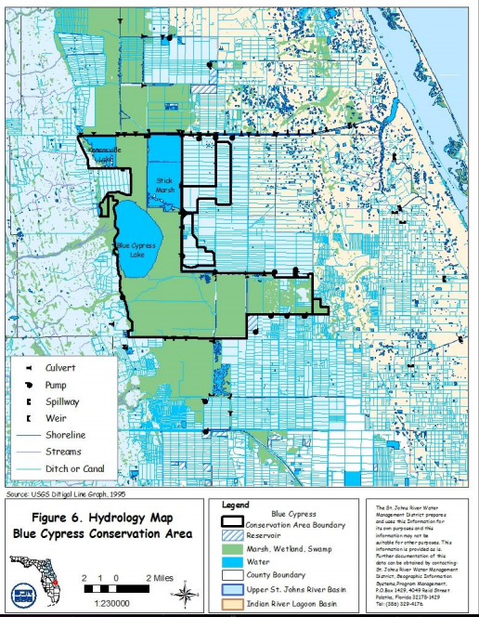
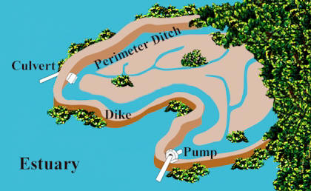
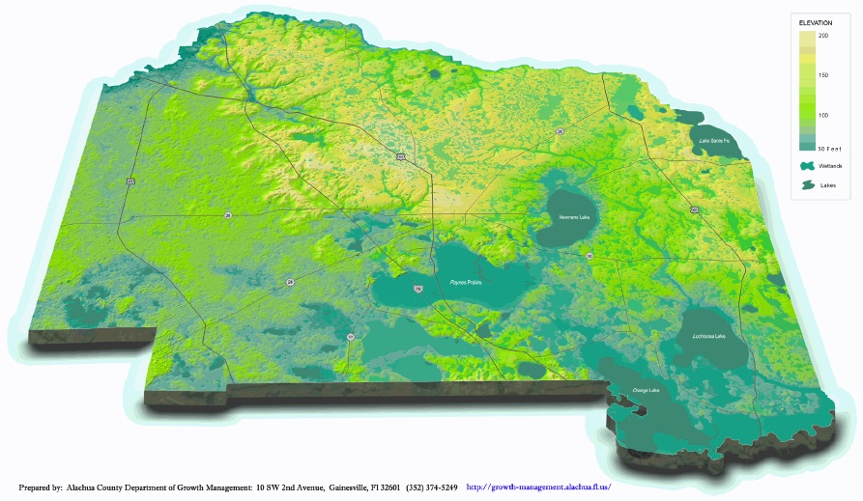
Assignments – Semester Project & Presentation
http://www.sms.si.edu/irlspec/Impoundments.htm

Slide 21

Assignments – Exams
Mid-term Exam – February 25th (in class)
No Final Exam!
Questions?

Slide 22

"Take A Break, Why Not!" February 2007
96"x48" Catalog #1427 $200 (shipping not available)
http://derekerdman.com/lup/pntgs/5/take_a_break_why_not.htm

Slide 23
Introduction to Wetland Treatment Systems
  Why WQ Treatment?
  WTS History
  WTS Types
  Applications
    Municipal
    Stormwater
    Industrial
    Agricultural
Outfall of a constructed WTS: Patterson, GA

Slide 24
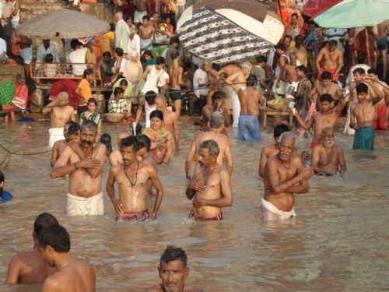
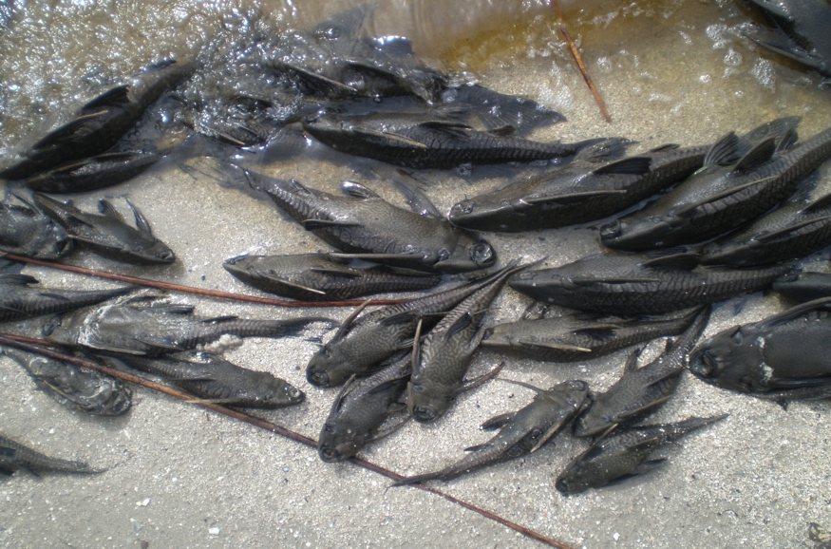
Introduction to Wetland Treatment Systems
  Why WQ Treatment?
http://shipbright.wordpress.com/
Lake Santa Fe, August 2008

Slide 25
Introduction to Wetland Treatment Systems
  Why WQ Treatment?
Human Health
Environmental Health
Pollution Sources:
Residential/commercial wastewater
Stormwater (point and NPS)
Agricultural wastewater
Industrial wastewater
http://shipbright.wordpress.com/
Types of Pollution:
Solids, sediment
Pathogens
Nutrients
Toxins
Lake Santa Fe, August 2008

Slide 26
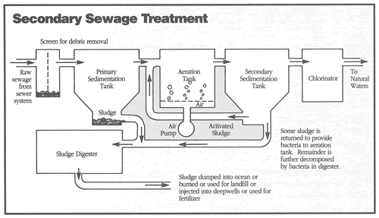
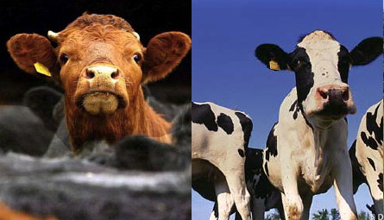
Introduction to Wetland Treatment Systems
  Why WQ Treatment?
Knight, 2007
http://soundbook.soundkeeper.org

Slide 27
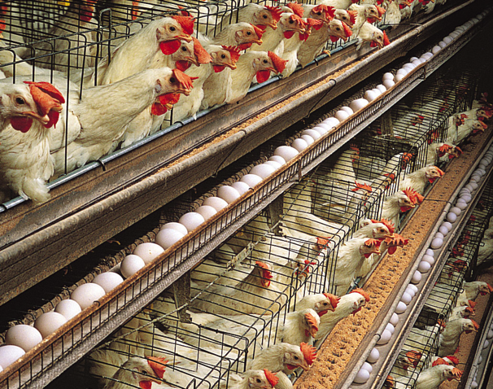
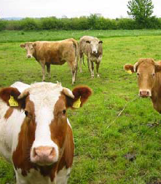
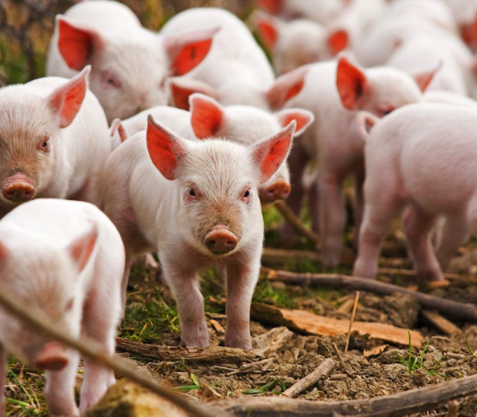
Introduction to Wetland Treatment Systems
  Why WQ Treatment?
Residential/commercial - “Municipal”
  230 to 380 liters/person/day
  15,600 permitted facilities in US
  30,000 MGD → 30 BGD(!)
Stormwater (point and NPS)
  HUGE volumes
  80% of pollutants in surface waters
Agricultural wastewater
  Cattle: 24 kg/animal/day * 100x10⁶ cows
  Swine: 2.7 kg/animal/day * 56x10⁶ pigs
  Poultry: 0.3 kg/animal/day * 390x10⁶ chickens
Industrial wastewater
  Chemical, pulp/paper, food processing, petroleum
  Example: 1890 MGD from US oil and gas
http://mukto-mona.com/
http://blog.oxforddictionaries.com

Slide 28
Introduction to Wetland Treatment Systems
  Why WQ Treatment?
Residential/commercial - “Municipal”
  230 to 380 liters/person/day
  15,600 permitted facilities in US
  30,000 MGD → 30 BGD(!)
Stormwater (point and NPS)
  HUGE volumes
  80% of pollutants in surface waters
Agricultural wastewater
  Cattle: 24 kg/animal/day * 100x10⁶ cows
  Swine: 2.7 kg/animal/day * 56x10⁶ pigs
  Poultry: 0.3 kg/animal/day * 390x10⁶ chickens
Industrial wastewater
  Chemical, pulp/paper, food processing, petroleum
  Example: 1890 MGD from US oil and gas
~800 MILLION PEOPLE!
http://mukto-mona.com/
http://mukto-mona.com/
http://blog.oxforddictionaries.com

Slide 29
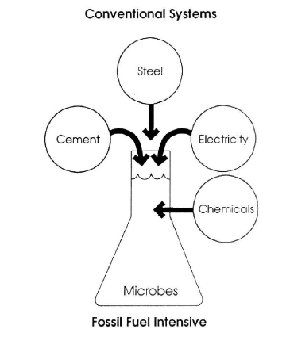
WTS vs. Conventional Treatment
Knight, 2007

Slide 30
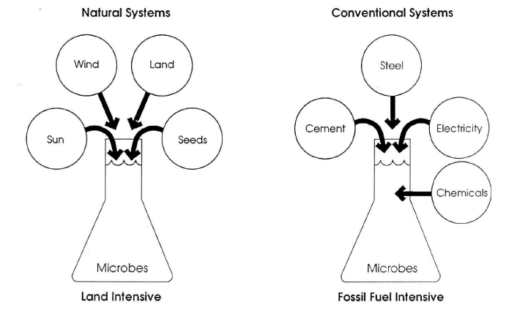
WTS vs. Conventional Treatment
Knight, 2007

Slide 31
WTS History…>100 Years (Documented)
  Wetlands as “convenient wastewater discharge sites” – Why?

Slide 32
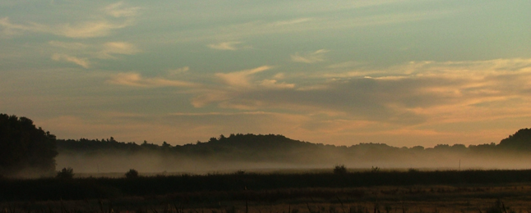
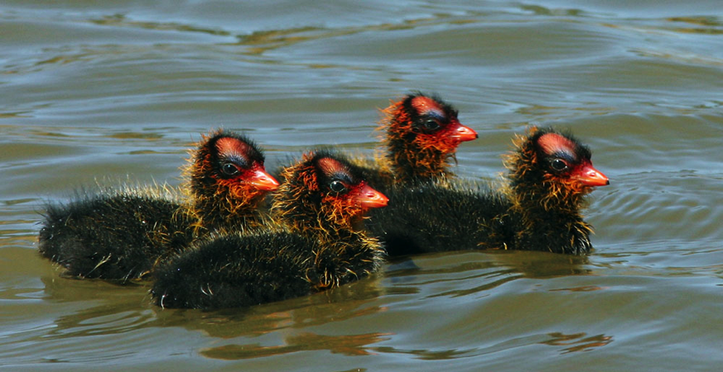
WTS History…>100 Years (Documented)
  Wetlands as “convenient wastewater discharge sites” – Why?
1912 – Great Meadows, MA (now a NWR)
1919 – Cootes Paradise, Hamilton, Ontario, CA
1923 – Brillion Marsh, WI
Photo: USFWS
Great Meadows NWR, Concord, MA
http://tgreybirds.com/AmericanCootChicksL.jpg
American coot (Fulica americana) chicks

Slide 33
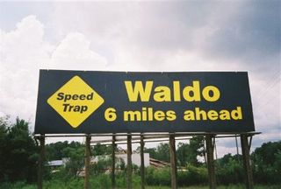
WTS History…>100 Years (Documented)
  Wetlands as “convenient wastewater discharge sites” – Why?
1912 – Great Meadows, MA (now a NWR)
1919 – Cootes Paradise, Hamilton, Ontario, CA
1923 – Brillion Marsh, WI
1939 – Waldo, FL!
Photo: USFWS
Great Meadows NWR, Concord, MA
http://tgreybirds.com/AmericanCootChicksL.jpg
http://waldoflsucks.com/
American coot (Fulica americana) chicks

Slide 34
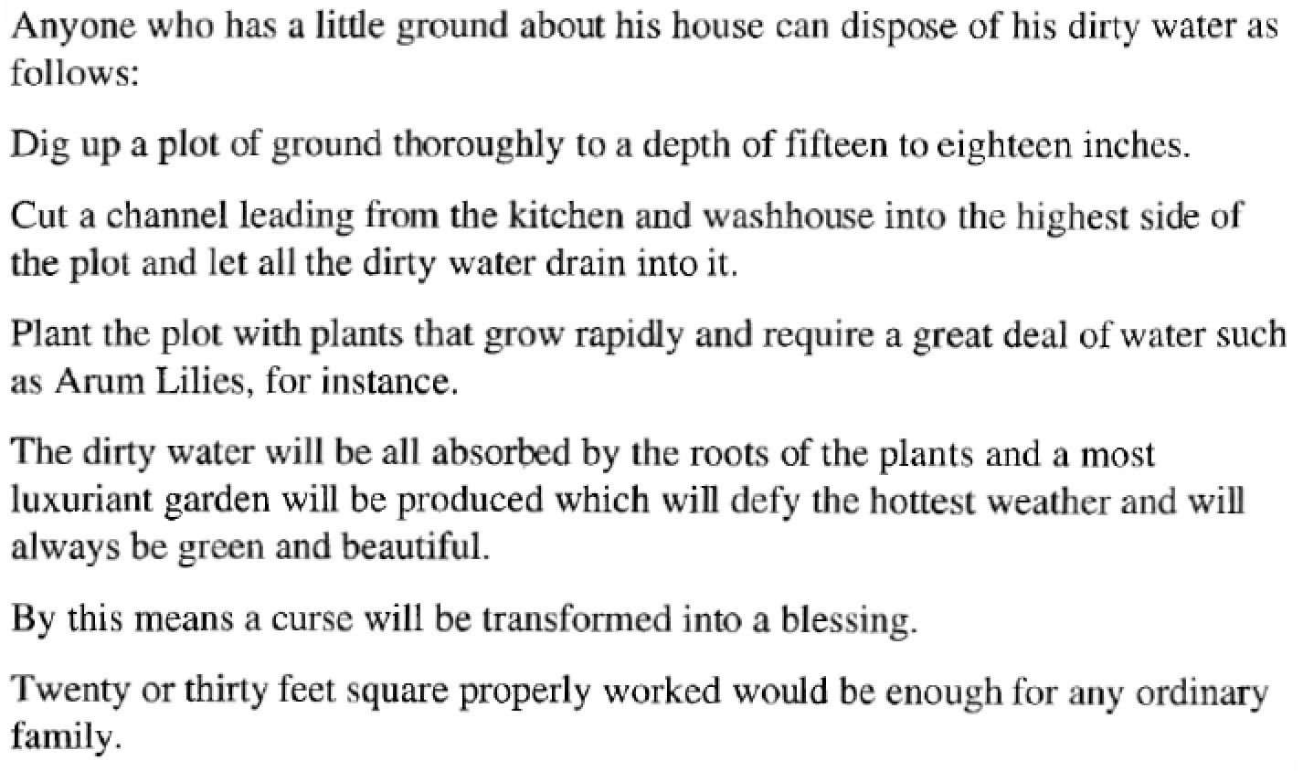
WTS History…>100 Years (Documented)
- Nemo, to the Hornsby literary Institute, 1904

Slide 35
WTS History…>100 Years (Documented)
- Nemo, to the Hornsby literary Institute, 1904

Slide 36
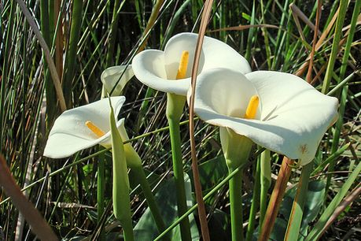
WTS History…>100 Years (Documented)
First Design Problem:
Calculate the wetland’s hydraulic loading rate (how many cm of water are added to the wetland per day)?
Assume an “ordinary family” has 6 people (in 1904)
Assume daily water use of 100 liters per person per day
Assume wetland is 25 ft² and 16” deep

Slide 37
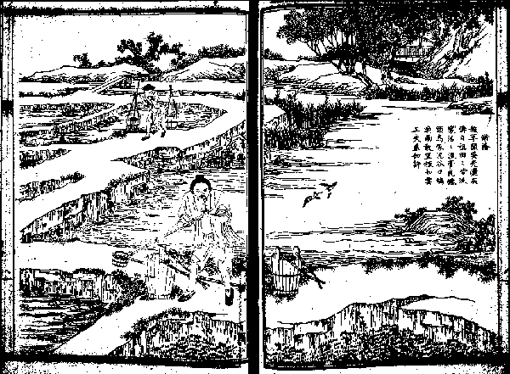
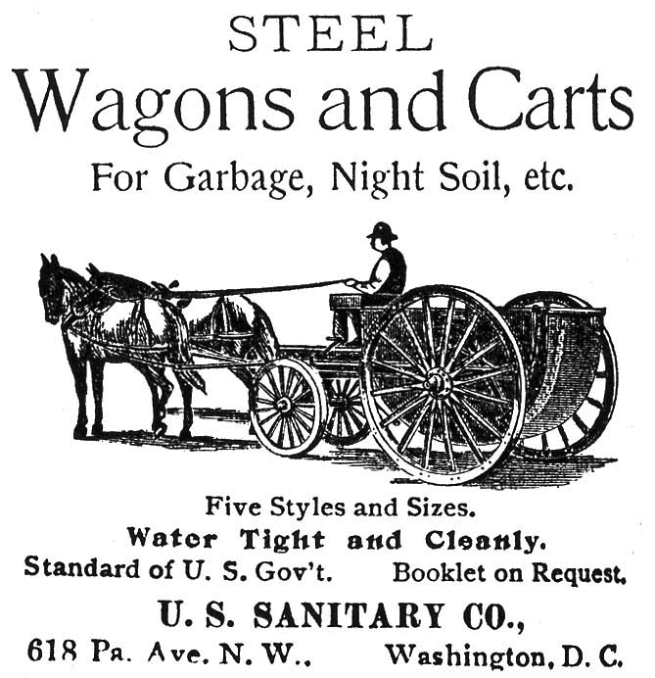
WTS History…Earlier Systems
Wastewater disposal into wetlands in China and Egypt for hundreds (thousands?) of years (Brix, 1994)
Qing Dynasty woodblock print (ca. 1600) of night soil fertilization in a rice paddy

Slide 38
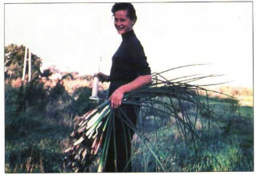
WTS History – Research
1952: Research at Max Planck Institute by Dr. Käthe Seidel (“Binsen-Käthe”)
“…to lessen the overfertilization, pollution and silting up of inland waters through appropriate plants so allowing the contaminated waters to be capable of supporting life once more…” (Seidel, 1978)
http://www.bestmann-green-systems.de
Dr. Seidel and bulrush stems, 1962

Slide 39
WTS History – Research
1952: Research at Max Planck Institute by Dr. Käthe Seidel (“Binsen-Käthe”)
“…to lessen the overfertilization, pollution and silting up of inland waters through appropriate plants so allowing the contaminated waters to be capable of supporting life once more…” (Seidel, 1978)
1960’s & 70’s: Continued research in Europe; first research in N. America
NC, MA, MI, NY, FL, MI, CA
Focus on natural systems (in US)
http://www.bestmann-green-systems.de
Dr. Seidel and bulrush stems, 1962
WTS conferences. Data from Table 1.2 in K&W
1985 – Present: Increased research and implementation globally
>2,000 systems in US
~10,000 systems worldwide

Slide 40
WTS Types
Treatment Wetlands (WTS)
Natural Wetlands
Constructed Wetlands
Surface Flow (FWS)
Subsurface Flow (SSF)
Floating Plants
Submerged Plants
Emergent Plants
Horizontal Flow (HF)
Vertical Flow (VF)
Modified from Fig. 1.2 in K&W

Slide 41
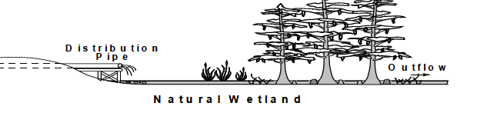

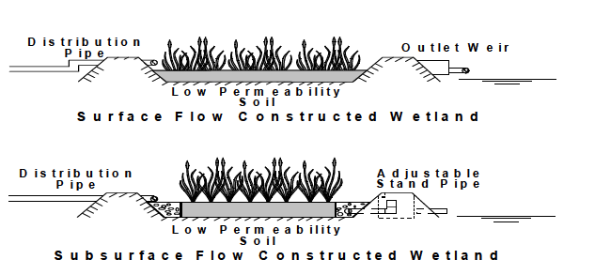
WTS Types
Knight, 2007

Slide 42
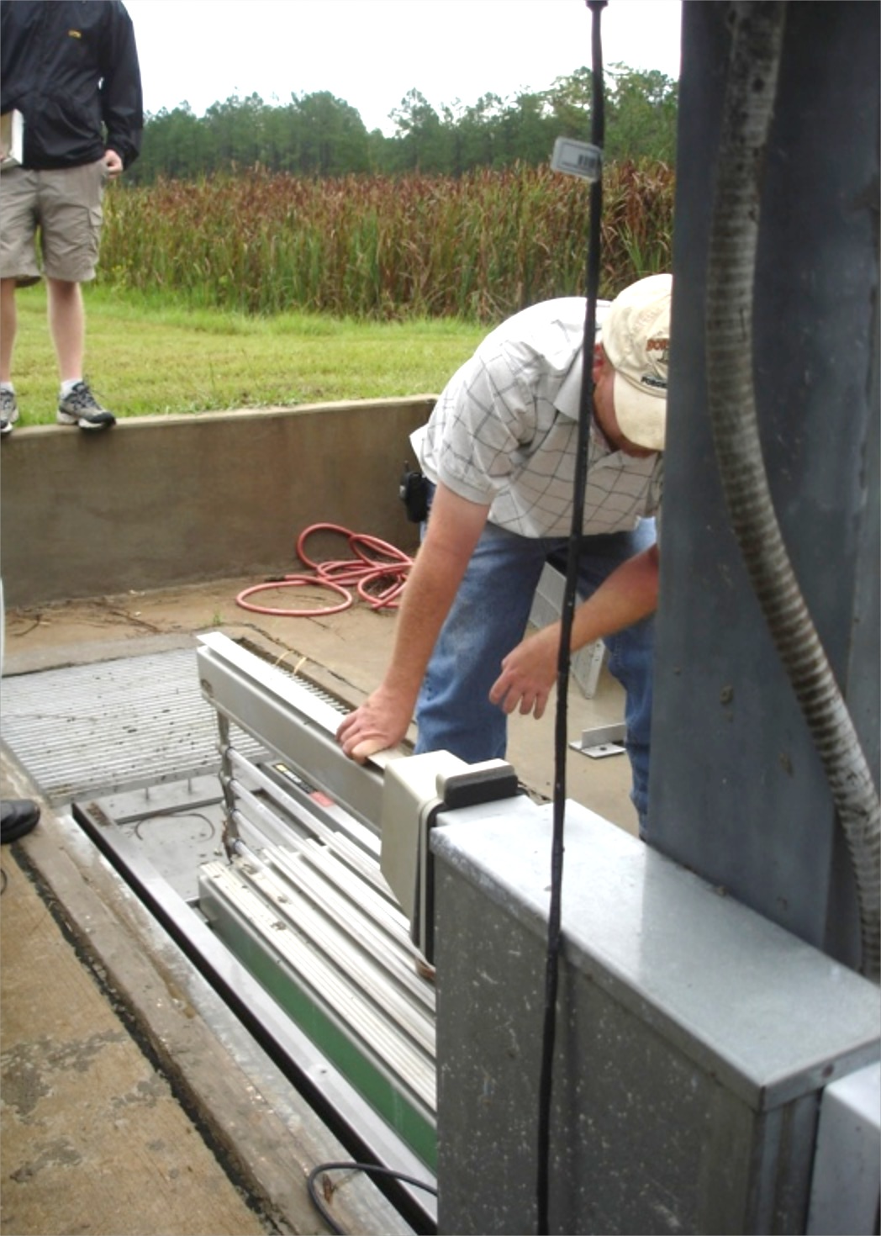
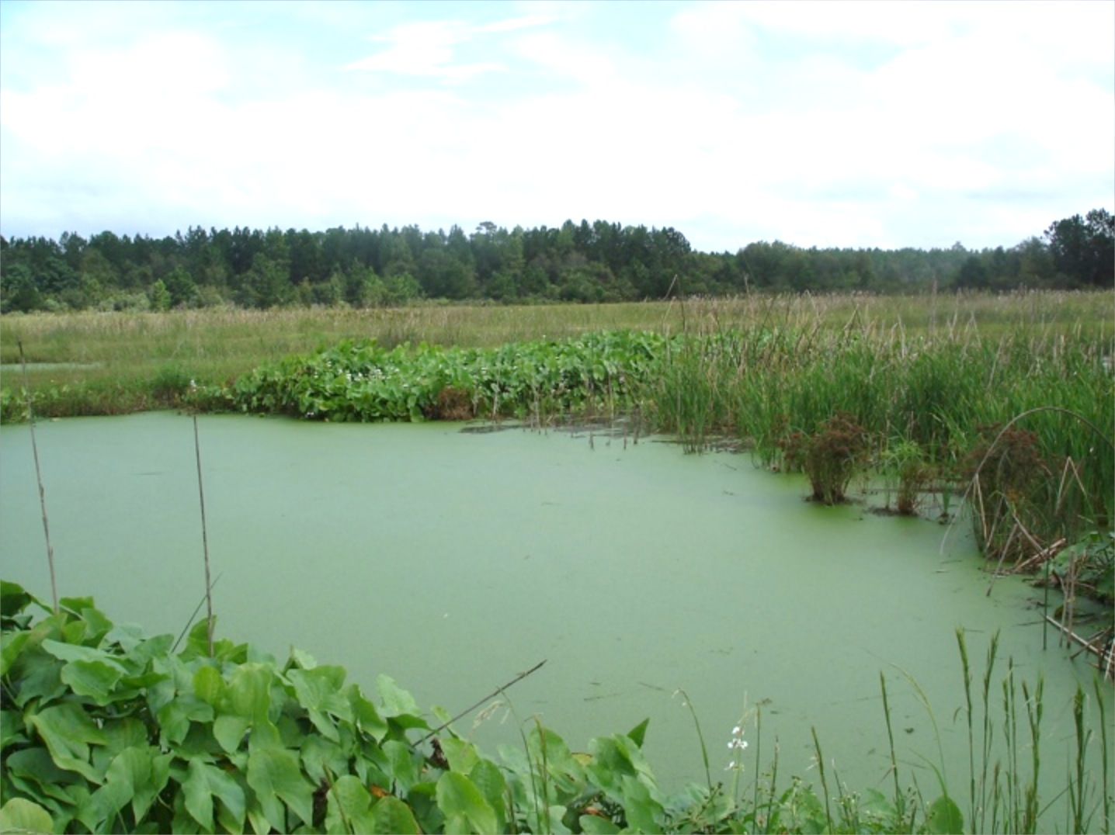
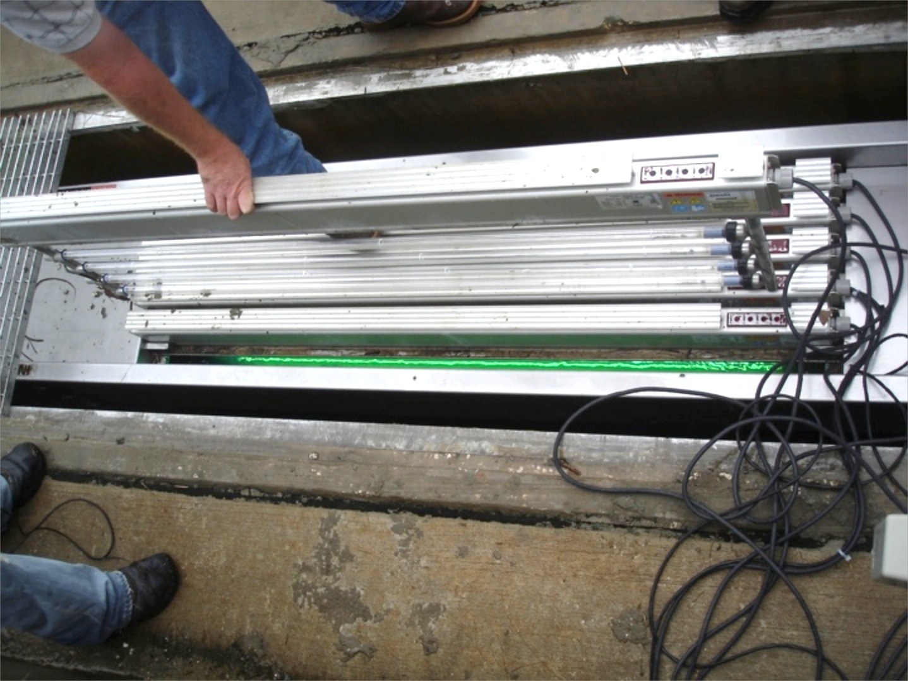
WTS Types – FWS
Fig. 1.4 in K&W
Municipal FWS WTS – Folkston, GA (2007)

Slide 43
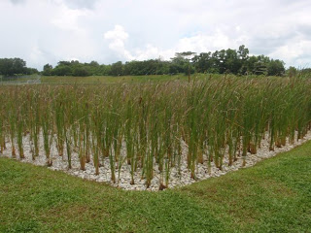



WTS Types – HSSF
http://waterqualityinsingapore.blogspot.com
Headley et al., 2005
http://en.wikipedia.org/
Knight, 2007

Slide 44


WTS Types – VF
Flow in pulses
Dispersed over surface
Can be maintained aerobic or anaerobic
Can treat very concentrated wastes
Downflow, upflow, recirculating
http://www.zer0-m.org/images/image008.jpg
Domingos, 2011

Slide 45

WTS Types – Hybrid Systems
Can set up an oxic – anoxic treatment train
Why would this be desirable?

Slide 46

WTS Types – Hybrid Systems
Can set up an oxic – anoxic treatment train
Why would this be desirable?
Hybrid System for Hotel Wastewater, Italy
Removal Rates
TSS: 84%
COD/BOD: 94%
NH₄⁺: 86%
TN: 60%
TP: 94%
Bacteria: 99.9%
http://wp.wpi.edu/capetown/files/2009/12/WaterandSanitation-italy.jpg

Slide 47



WTS Types – Pros and Cons
HSSF
VF
Primary Use
Water Level
Construction Cost
Pathogen Risk
Mosquitos?
Relative Costs
Flow Rates
Industrial WW?
Clogging?
Sediment Load
Wildlife Habitat
Reactive substrate
Cold climates
Oxygen levels
Deals with pulses?

Slide 48


WTS Types – Applications
Municipal Wastewaters
On-Site Systems
Secondary Treatment (BOD and TSS removal)
Advanced Secondary Treatment (NH₄ removal)
Tertiary Treatment (TN and TP removal)
Wildlife Habitat Creation
Public Use
http://www.ccwa.us/water-use
FWS WTS - 2º municipal WW (Patterson, GA)

Slide 49



WTS Types – Applications
Stormwaters
Urban Storage and Detention (flood control)
Urban Water Quality (TSS, oils & grease, nutrients, metals)
Industrial Sites (quantity and quality)
Combined Sewer Overflows
http://www.esf.edu/
Stormwater “BMP” on Staten Island, NY
http://www.blainc.com/greencso.htm

Slide 50


WTS Types – Applications
Industrial Wastewaters
Petroleum (refineries, pumping stations, storage facilities)
Pulp & Paper (process wastewaters)
Food Processing
Landfill Leachates
Acid Mine Drainage
Issues?
Knight, 2007
Hybrid WTS for treatment of industrial wastewater from oil and gas processing plant
(Wallace & Kadlec, 2004)

Slide 51



WTS Types – Applications
Agricultural Wastewaters
Concentrated Animal Feeding Operations (CAFOs)
  Dairy, Swine, Poultry, Aquaculture
Runoff from farming operations
  On-farm buffer strips
  Downstream treatment
www.pewenvironment.org
www.pewenvironment.org
http://www.agry.purdue.edu
Poultry house wastewater lagoon

Slide 52
WTS Types – Applications
WTS can provide high levels of treatment for many pollutants at (relatively) low cost, while providing ancillary benefits…

Slide 53
WTS Types – Applications
WTS can provide high levels of treatment for many pollutants at (relatively) low cost, while providing ancillary benefits…
…however, removal efficiencies & effluent concentrations are VERY dependent on influent concentration and hydraulic loading rate

Slide 54




For Next Week: 3 Things
EDGE Students: Post an introduction to the online discussion
Read: Chapters 1-3 in K&W.
Review reading list and think about what topic you want to write your synthesis paper on.
2015
2013

